Slide 1
Relative Coordinates

Slide 2
Example 1
You wish to draw a triangle on the screen. The base of the triangle is 100 pixels and the height is 60 pixels

Slide 3
Step 1: Pre-plan how to draw
Sketch a drawing of what it is you want to draw
Choose a point for reference. Label that point (x, y)‏
Label the dimensions of your drawing.
Label important points of your drawing relative to (x, y)‏

Slide 4
Ex. 1 A screen 640 x 500
(0, 0)‏
(639, 0)‏
(x, y)‏
60
100
(0, 499)‏
(639, 499)‏

Slide 5
Ex. 1 Console Window
(0, 0)‏
(639, 0)‏
(x, y)‏
(x+50, y)‏
60
(x, y + 60)‏
100
(x + 100, y + 60)‏
(0, 499)‏
(639, 499)‏

Slide 6
Step 2 – Convert to Python
Ensure you have all the necessary points in your drawing labeled
Declare variables x and y and assign them values. (You may need to adjust them later)‏
Write the necessary drawing commands

Slide 7
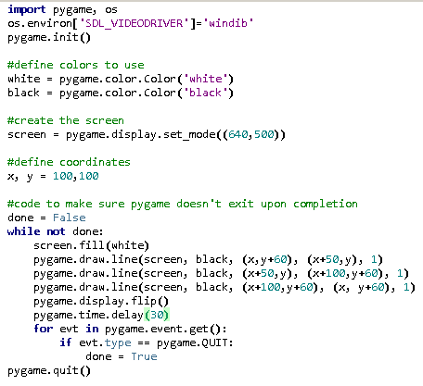
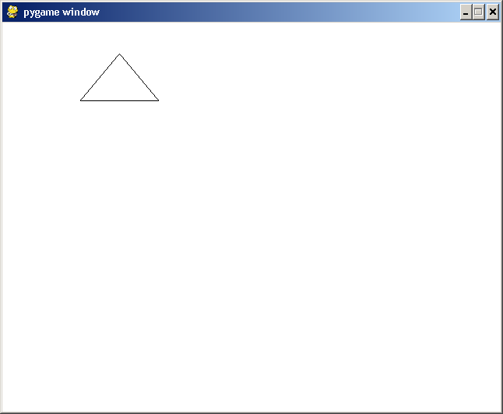
Python Triangle
(x+50, y)‏
(x, y+60)‏
(x+100, y+60)‏

Slide 8
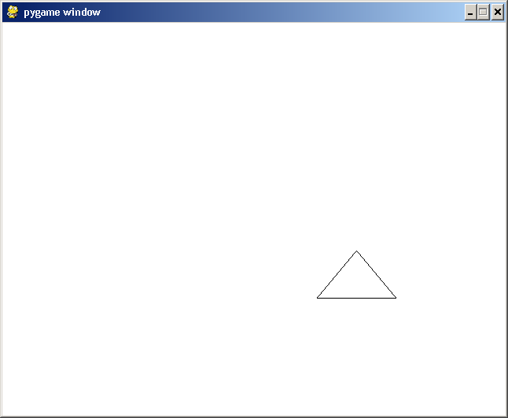
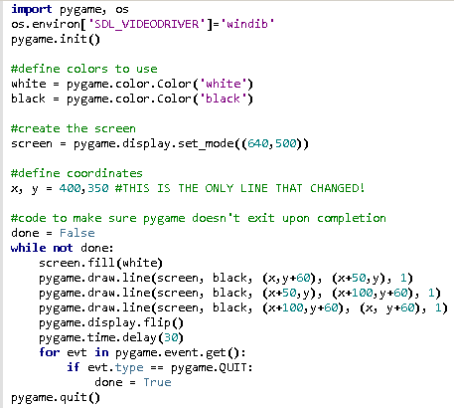
Python Triangle (x & y changed)‏

Slide 9
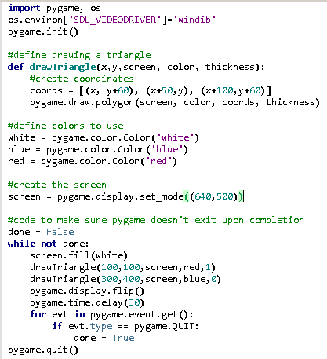
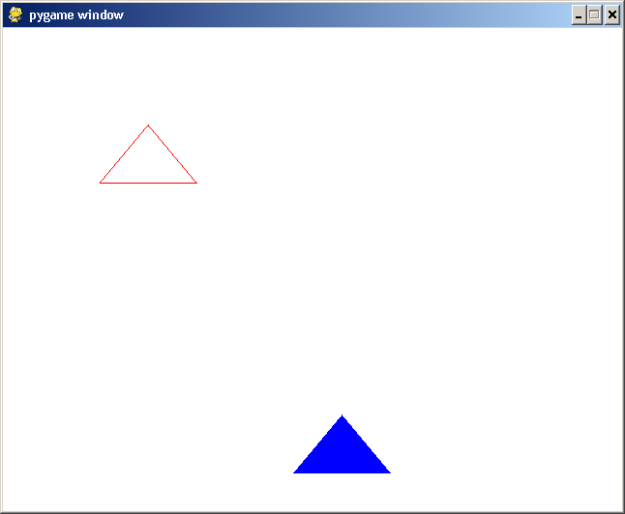
Python Triangle as a Polygon (3U)

Slide 10
Example 2 - Tree
Draw a tree using a brown rectangle and a green oval
  The brown rectangle represents the trunk
  The green oval represents the leaves

Slide 11
Ex. 2 Python Window Window
(0, 0)‏
(639, 0)‏
Oval centre halfway between
box and 15 pixels above box
(x, y)‏
Oval radius 40
100
10
(0, 499)‏
(639, 499)‏

Slide 12
Ex. 2 Python Screen
(0, 0)‏
(6390)‏
(x, y)‏
(x+35, y+55)‏
Ellipse width = 80
Ellipse height = 80
100
10
(0, 499)‏
(639, 499)‏

Slide 13
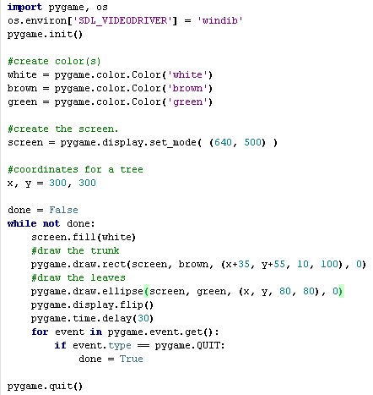
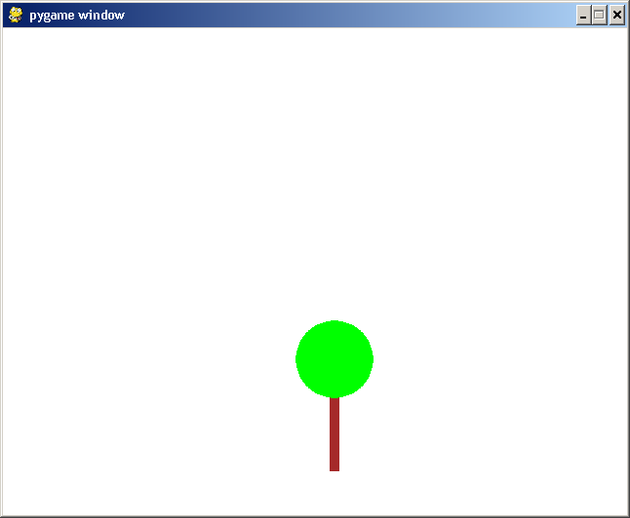
Python Tree (no functions)

Slide 14
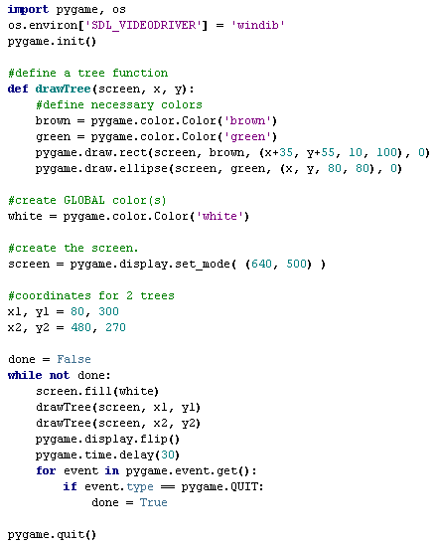
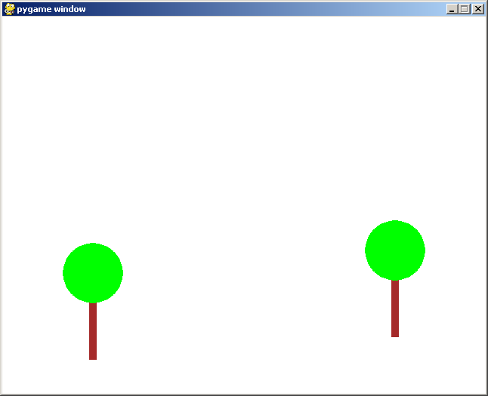
Python Tree (with functions)

Slide 15
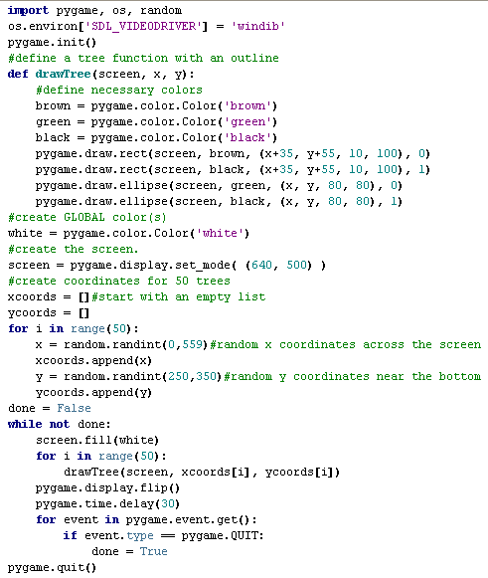
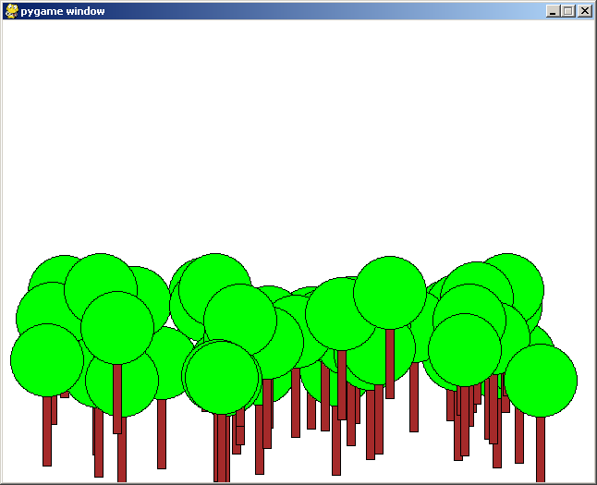
Python Forest

